Slide 1
Robot Sensing and Sensors
Introduction to ROBOTICS
Dr. John (Jizhong) Xiao
Department of Electrical Engineering
City College of New York
jxiao@ccny.cuny.edu

Slide 2
Brief Review
(Mobot Locomotion)

Slide 3
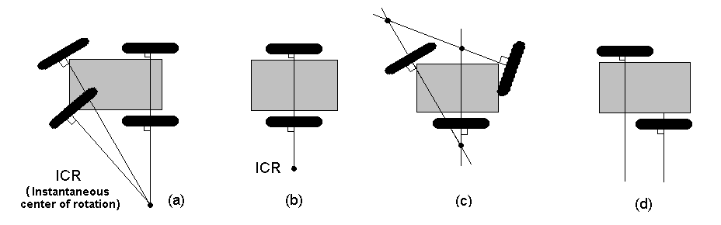
ICR of wheeled mobile robot
Instantaneous center of rotation (ICR)
  A cross point of all axes of the wheels

Slide 4
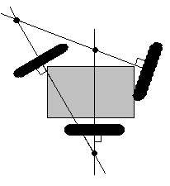
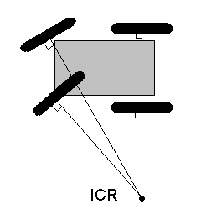
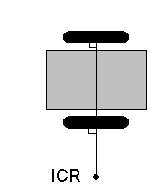
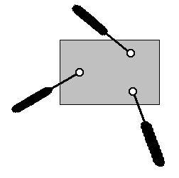
Degree of Mobility
Degree of mobility
  The degree of freedom of the robot motion
Cannot move anywhere (No ICR)
Fixed arc motion (Only one ICR)
Degree of mobility : 0
Degree of mobility : 1
Fully free motion
( ICR can be located at any position)
Variable arc motion (line of ICRs)
Degree of mobility : 2
Degree of mobility : 3

Slide 5
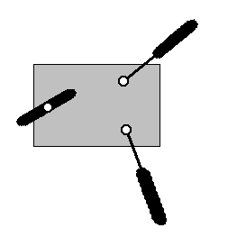
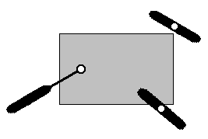
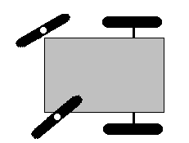
Degree of Steerability
Degree of steerability
  The number of centered orientable wheels that can be steered independently in order to steer the robot
No centered orientable wheels
Degree of steerability : 0
One centered orientable wheel
Two mutually dependent centered orientable wheels
Two mutually independent centered orientable wheels
Degree of steerability : 1
Degree of steerability : 2

Slide 6
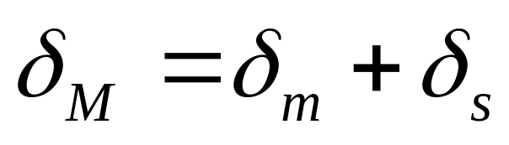
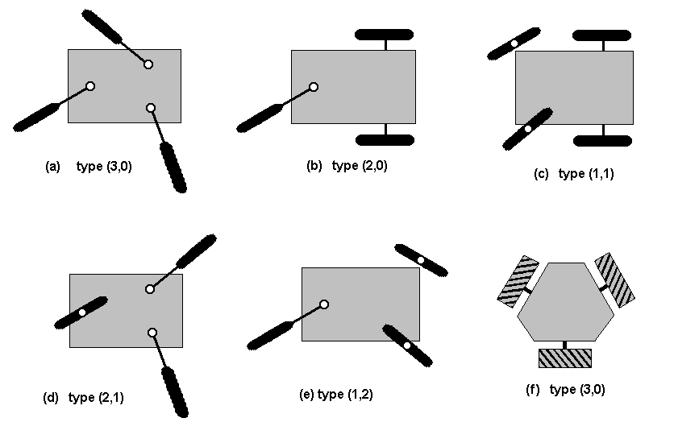
Degree of Maneuverability
The overall degrees of freedom that a robot can manipulate:
Degree of Mobility 3 2 2 1 1
Degree of Steerability 0 0 1 1 2
Examples of robot types (degree of mobility, degree of steerability)

Slide 7
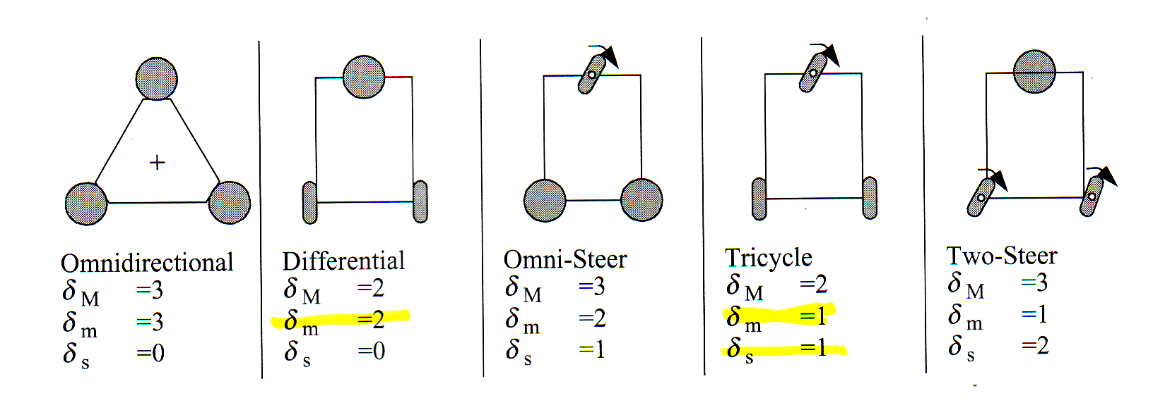
Degree of Maneuverability

Slide 8
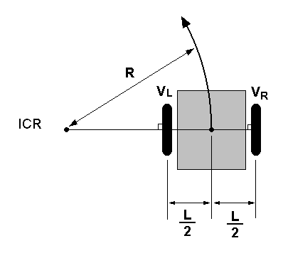
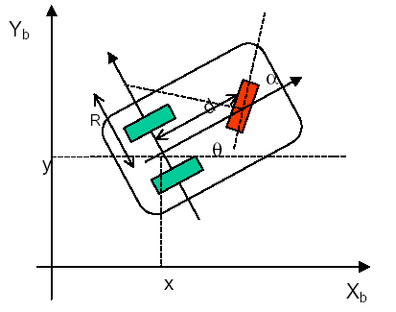
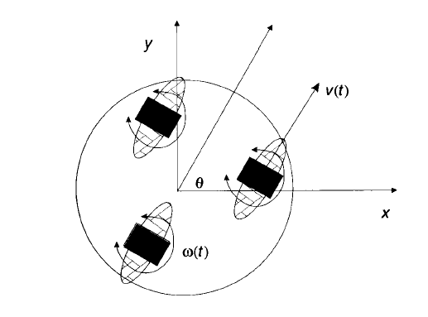
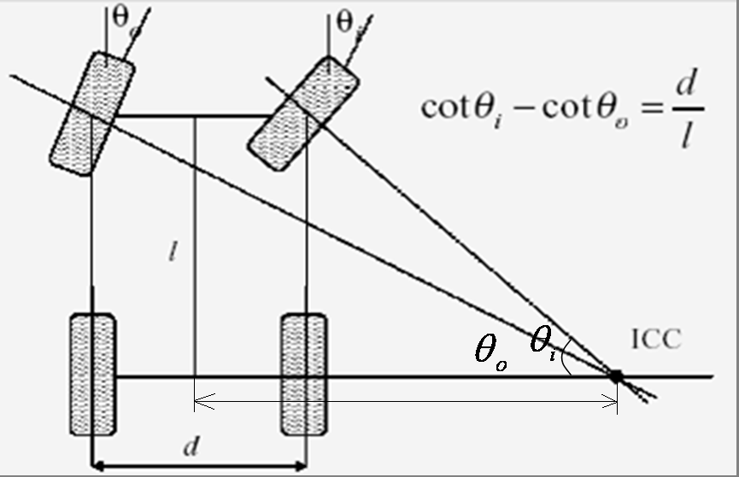
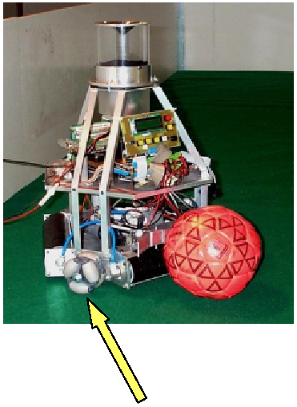
Mobile Robot Locomotion
Locomotion: the process of causing a robot to move
  Differential Drive
  Tricycle
R
Swedish Wheel
  Synchronous Drive
  Ackerman Steering
  Omni-directional

Slide 9
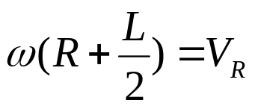
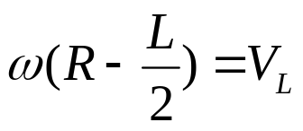
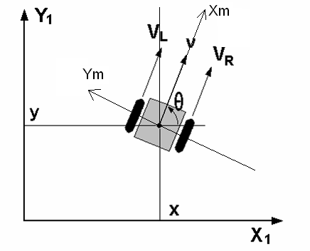

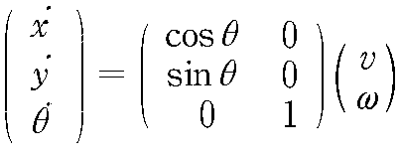

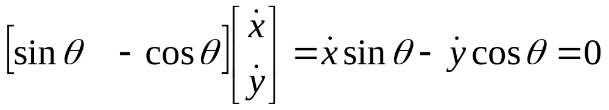
Differential Drive
Property: At each time instant, the left and right wheels must follow a trajectory that moves around the ICC at the same angular rate ω, i.e.,
Kinematic equation
Nonholonomic Constraint
Notes:
(Eq1)
(Eq2)
Eq1-Eq2

Slide 10


Differential Drive
Basic Motion Control
  R : Radius of rotation
Straight motion
  R = Infinity VR = VL
Rotational motion
  R = 0 VR = -VL

Slide 11
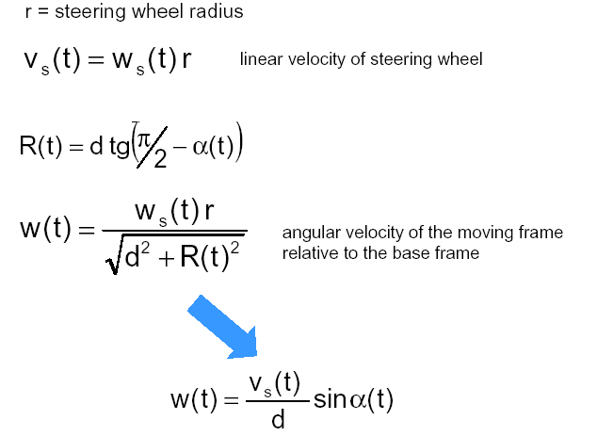
Tricycle
Steering and power are provided through the front wheel
control variables:
  angular velocity of steering wheel w_{s}(t)
  steering direction α(t)
d: distance from the front wheel to the rear axle

Slide 12
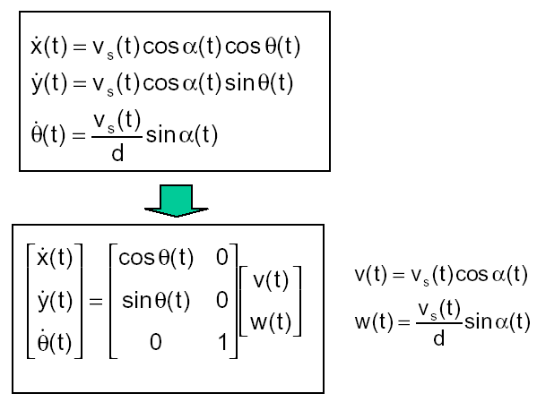
Tricycle
Kinematics model in the world frame
---Posture kinematics model

Slide 13
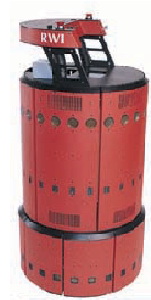
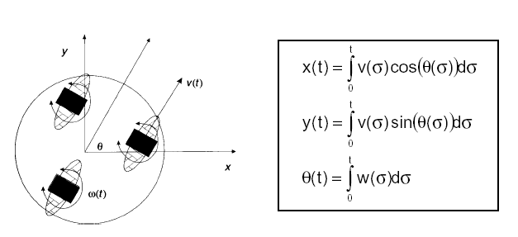
Synchronous Drive
All the wheels turn in unison
  All wheels point in the same direction and turn at the same rate
  Two independent motors, one rolls all wheels forward, one rotate them for turning
Control variables (independent)
  v(t), ω(t)

Slide 14
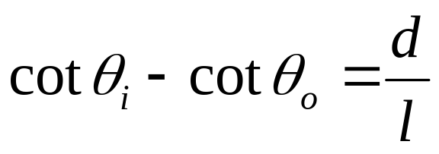
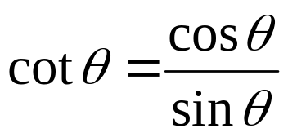
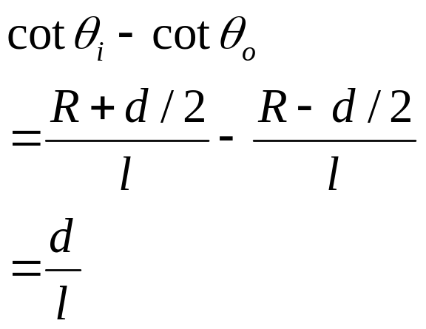
Ackerman Steering (Car Drive)
The Ackerman Steering equation:
  :
R

Slide 15
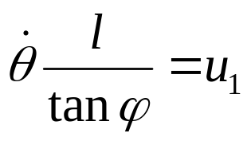


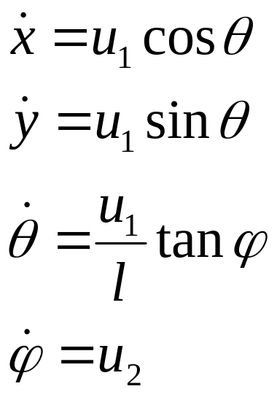



Car-like Robot
Driving type: Rear wheel drive, front wheel steering
ICC
Y
ϕ
Rear wheel drive car model:
R
ϕ
θ
l
X
: forward velocity of the rear wheels
: angular velocity of the steering wheels
non-holonomic constraint:
l : length between the front and rear wheels

Slide 16
Robot Sensing and Sensors

Slide 17
References
Sensors for mobile robots: theory and applications, H. R. Everett, A. K. Peters Ltd, C1995, ISBN: 1-56881-048-2
Handbook of Modern Sensors: Physics, Designs and Applications, 2nd edition,
Jacob Fraden, AIP Press/Springer, 1996.
ISBN 1-56396-538-0.

Slide 18
Some websites
http://www.omega.com/ (sensors + hand-helds)
http://www.extech.com/ (hand-helds)
http://www.agilent.com/ (instruments, enormous)
http://www.keithley.com/ (instruments, big)
http://www.tegam.com/ (instruments, small)
http://www.edsci.com/ (optics ++)
http://www.pacific.net/~brooke/Sensors.html
(comprehensive listing of sensors etc. and links)

Slide 19
What is Sensing ?
Collect information about the world
Sensor - an electrical/mechanical/chemical device that maps an environmental attribute to a quantitative measurement
Each sensor is based on a transduction principle - conversion of energy from one form to another

Slide 20
Human sensing and organs
Vision: eyes (optics, light)
Hearing: ears (acoustics, sound)
Touch: skin (mechanics, heat)
Odor: nose (vapor-phase chemistry)
Taste: tongue (liquid-phase chemistry)
Counterpart?

Slide 21
Extended ranges and modalities
Vision outside the RGB spectrum
  Infrared Camera, see at night
Active vision
  Radar and optical (laser) range measurement
Hearing outside the 20 Hz – 20 kHz range
  Ultrasonic range measurement
Chemical analysis beyond taste and smell
Radiation: α, β, γ-rays, neutrons, etc

Slide 22
Transduction to electronics
Thermistor: temperature-to-resistance
Electrochemical: chemistry-to-voltage
Photocurrent: light intensity-to-current
Pyroelectric: thermal radiation-to-voltage
Humidity: humidity-to-capacitance
Length (LVDT: Linear variable differential transformers) : position-to-inductance
Microphone: sound pressure-to-<anything>

Slide 23
Sensor Fusion and Integration
Human: One organ ⬄one sense?
  Not necessarily
    Balance: ears
    Touch: tongue
    Temperature: skin
Robot:
  Sensor fusion:
    Combine readings from several sensors into a (uniform) data structure
  Sensor integration:
    Use information from several sensors to do something useful

Slide 24
Sensor Fusion
One sensor is (usually) not enough
  Real sensors are noisy
  Limited Accuracy
  Unreliable - Failure/redundancy
  Limited point of view of the environment
    Return an incomplete description of the environment
  The sensor of choice may be expensive - might be cheaper to combine two inexpensive sensors

Slide 25
General Processing
Sensor
Preprocessing
Sensor
Preprocessing
Fusion
Interpretation
Sensor
Preprocessing
Sensor
Preprocessing
Sensing
Perception

Slide 26
Preprocessing
Colloquially - ‘cleanup’ the sensor readings before using them
Noise reduction - filtering
Re-calibration
‘Basic’ stuff - e.g. edge detection in vision
Usually unique to each sensor
Change (transform) data representation

Slide 27
Sensor/Data Fusion
Combine data from different sources
  measurements from different sensors
  measurements from different positions
  measurements from different times
Often a mathematical technique that takes into account uncertainties in data sources
  Discrete Bayesian methods
  Neural networks
  Kalman filtering
Produces a merged data set (as though there was one ‘virtual sensor’)

Slide 28
Interpretation
Task specific
Often modeled as a best fit problem given some a priori knowledge about the environment
Tricky

Slide 29
Classification of Sensors
Proprioception (Internal state) v.s. Exteroceptive (external state)
  measure values internally to the system (robot), e.g. battery level, wheel position, joint angle, etc,
  observation of environments, objects
Active v.s. Passive
  emitting energy into the environment, e.g., radar, sonar
  passively receive energy to make observation, e.g., camera
Contact v.s. non-contact
Visual v.s. non-visual
  vision-based sensing, image processing, video camera

Slide 30
Proprioceptive Sensors
Encoders, Potentiometers
  measure angle of turn via change in resistance or by counting optical pulses
Gyroscopes
  measure rate of change of angles
  fiber-optic (newer, better), magnetic (older)
Compass
  measure which way is north
GPS: measure location relative to globe

Slide 31
Touch Sensors
Whiskers, bumpers etc.
  mechanical contact leads to
    closing/opening of a switch
    change in resistance of some element
    change in capacitance of some element
    change in spring tension
    ...

Slide 32
Sensors Based on Sound
SONAR: Sound Navigation and Ranging
  bounce sound off of objects
  measure time for reflection to be heard - gives a range measurement
  measure change in frequency - gives the relative speed of the object (Doppler effect)
  bats and dolphins use it with amazing results
  robots use it w/ less than amazing results

Slide 33
Sensors Based on EM Spectrum

Slide 34

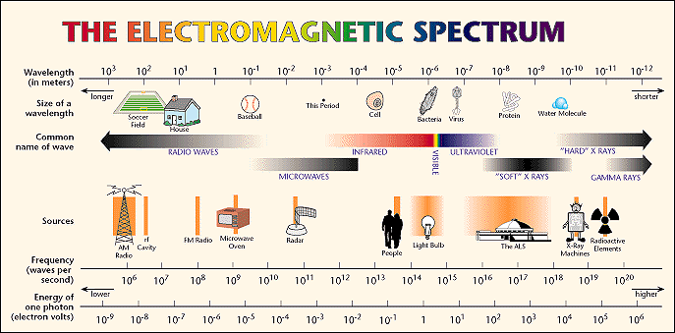
Electromagnetic Spectrum
Visible Spectrum
700 nm
400 nm
Notes:
An electromagnetic wave, although it carries no mass, does carry energy. It also has momentum, and can exert pressure (known as radiation pressure). The reason tails of comets point away from the Sun is the radiation pressure exerted on the tail by the light (and other forms of radiation) from the Sun.
The energy carried by an electromagnetic wave is proportional to the frequency of the wave. The wavelength and frequency of the wave are connected via the speed of light:
C=fλ
Electromagnetic waves are split into different categories based on their frequency (or, equivalently, on their wavelength). In other words, we split up the electromagnetic spectrum based on frequency. Visible light, for example, ranges from violet to red. Violet light has a wavelength of 400 nm, and a frequency of 7.5 x 10¹⁴ Hz. Red light has a wavelength of 700 nm, and a frequency of 4.3 x 10¹⁴ Hz. Any electromagnetic wave with a frequency (or wavelength) between those extremes can be seen by humans.
Visible light makes up a very small part of the full electromagnetic spectrum. Electromagnetic waves that are of higher energy than visible light (higher frequency, shorter wavelength) include ultraviolet light, X-rays, and gamma rays. Lower energy waves (lower frequency, longer wavelength) include infrared light, microwaves, and radio and television waves.
Shortest Wavelengths \ Highest Frequency: Gamma rays are radiation from nuclear decay, when a nucleus changes from an excited energy state to a lower energy state. Gamma rays are typically waves of frequencies greater than 10¹⁹ Hz. They have high energies (greater than 10⁴ eV per photon) and extremely short wavelengths (less than 10⁻¹⁴ m). Gamma rays can penetrate nearly all materials and are therefore difficult to detect. Gamma rays have mostly been detected in the activities in space such as the Crab Nebula and the Vela Pulsar. The highest frequency of gamma rays that have been detected is 10³⁰Hz measured from diffuse gamma ray emissions.
Longest Wavelength \ Lowest Frequency: Several textbooks cite the frequency of the lowest electromagnetic waves on the order of 10² Hertz (Hz) and such waves are classified as Extremely Low Frequency (ELF). However, it has been discovered that the frequency of the lowest electromagnetic waves is on the order of the 10⁻³ Hz (millihertz or mHz) and are known as micropulsations. Micropulsations or geomagnetic pulsations are responses to changes in the magnetosphere. The magnetosphere is a cavity in the solar wind, which is the result of the geomagnetic field (earth's magnetic field) impeding the direct entry of the ionized gas (plasma) of the solar wind into the cavity. Micropulsations were first observed and published by Balfour Steward in 1861. He described pulsations with frequencies ranging from 3 mHz to 30 mHz. Today, geomagnetic pulsations cover the frequency range from 1 mHz to 1 Hz. Pulsations are divided into two classes, continuous and irregular, each of which are further divided according to the period of the pulsations.
Crab Nebula- nebula=galaxy, cloudlike masses of gases or dust among the stars
Vela Pulsar
micropulsations

Slide 35
Sensors Based on EM Spectrum
Radio and Microwave
  RADAR: Radio Detection and Ranging
  Microwave radar: insensitive to clouds
Coherent light
  all photons have same phase and wavelength
  LASER: Light Amplification by Stimulated Emission of Radiation
  LASER RADAR: LADAR - accurate ranging

Slide 36
Sensors Based on EM Spectrum
Light sensitive
  eyes, cameras, photocells etc.
  Operating principle
    CCD - charge coupled devices
    photoelectric effect
IR sensitive
  Local Proximity Sensing
    Infrared LEDs (cheap, active sensing)
    usually low resolution - normally used for presence/absence of obstacles rather than ranging, operate over small range
  Sense heat differences and construct images
    Human detection sensors
    night vision application

Slide 37
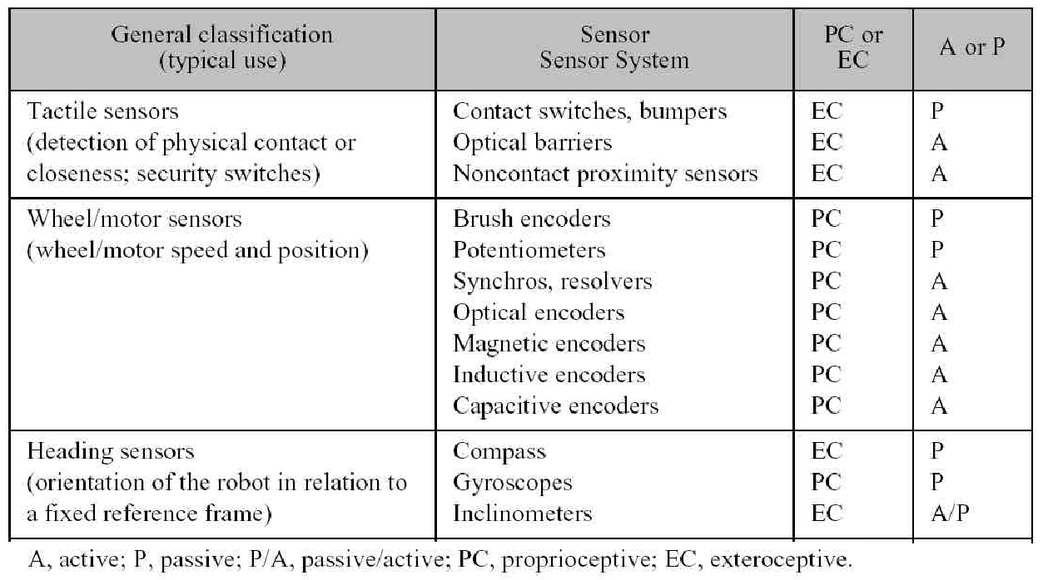
General Classification (1)

Slide 38
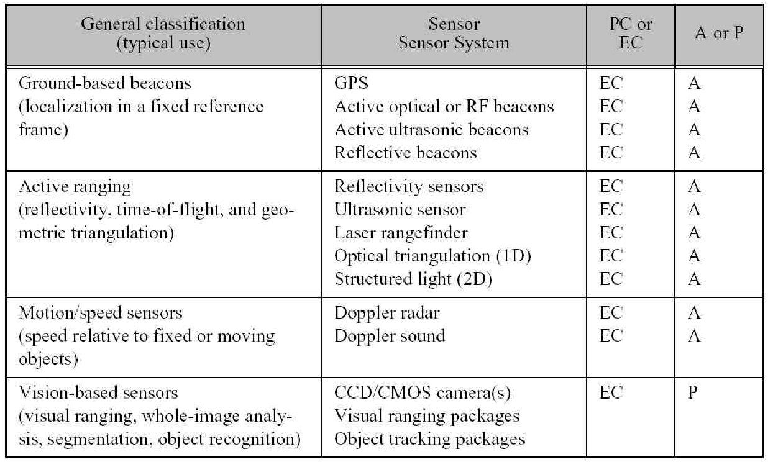
General Classification (2)

Slide 39
Sensors Used in Robot

Slide 40
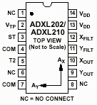

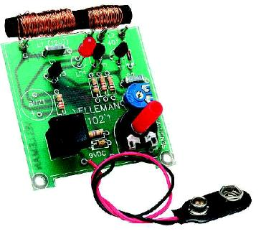

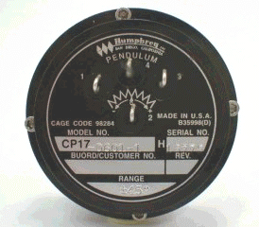



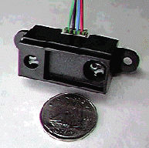



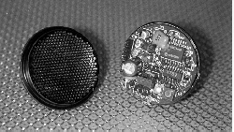


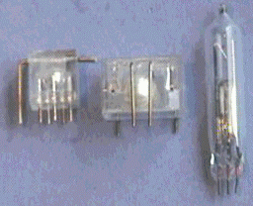
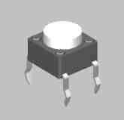



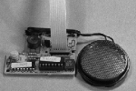

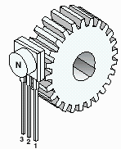


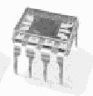
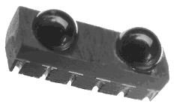

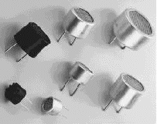


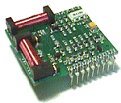

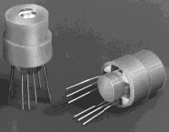

Accelerometer
Gyro
Gas Sensor
Pendulum Resistive
Tilt Sensors
Metal Detector
Piezo Bend Sensor
Gieger-Muller
Radiation Sensor
Pyroelectric Detector
Resistive Bend Sensors
UV Detector
CDS Cell
Resistive Light Sensor
Digital Infrared Ranging
Pressure Switch
Miniature Polaroid Sensor
Limit Switch
Touch Switch
Mechanical Tilt Sensors
IR Pin
Diode
IR Sensor w/lens
Thyristor
Magnetic Sensor
Hall Effect
Magnetic Field
Sensors
Polaroid Sensor Board
IR Reflection
Sensor
IR Amplifier Sensor
Magnetic Reed Switch
IRDA Transceiver
Lite-On IR
Remote Receiver
Radio Shack
Remote Receiver
IR Modulator
Receiver
Solar Cell
Compass
Compass
Piezo Ultrasonic Transducers

Slide 41
Sensors Used in Robot
Resistive sensors
  bend sensors, potentiometer, resistive photocells, ...
Tactile sensors
  contact switch, bumpers…
Infrared sensors
  Reflective, proximity, distance sensors…
Ultrasonic Distance Sensor
Inertial Sensors (measure the second derivatives of position)
  Accelerometer, Gyroscopes,
Orientation Sensors
  Compass, Inclinometer
Laser range sensors
Vision, GPS, …

Slide 42
Resistive Sensors

Slide 43

Resistive Sensors
Bend Sensors
Resistance = 10k to 35k
As the strip is bent, resistance increases
Potentiometers
Can be used as position sensors for sliding mechanisms or rotating shafts
Easy to find, easy to mount
Light Sensor (Photocell)
Good for detecting direction/presence of light
Non-linear resistance
Slow response to light changes
Resistive Bend Sensor
Potentiometer
Photocell
R is small when brightly illuminated

Slide 44
Applications
Sensor
Measure bend of a joint
Wall Following/Collision Detection
Weight Sensor
Sensors
Sensor

Slide 45
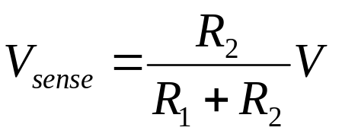
Inputs for Resistive Sensors
Voltage divider:
You have two resisters, one
is fixed and the other varies,
as well as a constant voltage
V
R1
Vsense
R2
A/D converter
micro
V
+
Binary
Threshold
Digital I/O
-
Comparator:
If voltage at + is greater than at -, digital high out

Slide 46
Infrared Sensors
Intensity based infrared
  Reflective sensors
  Easy to implement
  susceptible to ambient light
Modulated Infrared
  Proximity sensors
  Requires modulated IR signal
  Insensitive to ambient light
Infrared Ranging
  Distance sensors
  Short range distance measurement
  Impervious to ambient light, color and reflectivity of object

Slide 47
Intensity Based Infrared
Break-Beam sensor
Reflective Sensor
Increase in ambient light
raises DC bias
voltage
Easy to implement (few components)
Works very well in controlled environments
Sensitive to ambient light
time
voltage
time

Slide 48
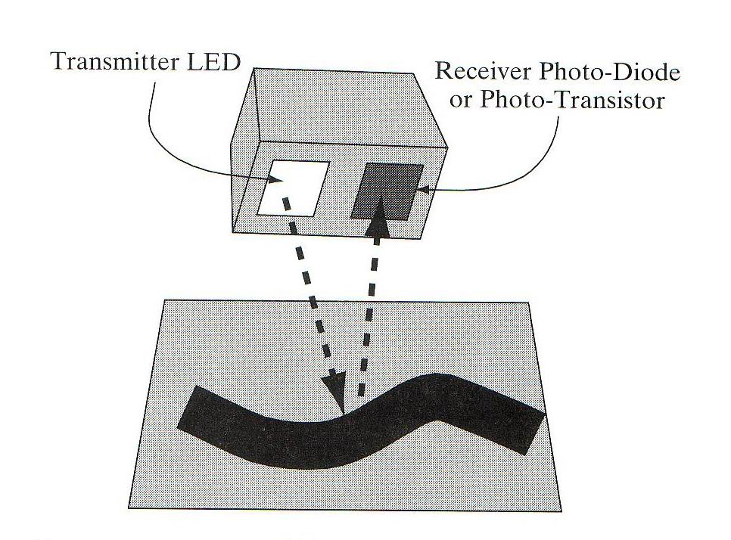
IR Reflective Sensors
Reflective Sensor:
  Emitter IR LED + detector photodiode/phototransistor
  Phototransistor: the more light reaching the phototransistor, the more current passes through it
  A beam of light is reflected off a surface and into a detector
  Light usually in infrared spectrum, IR light is invisible
Applications:
  Object detection,
  Line following, Wall tracking
  Optical encoder (Break-Beam sensor)
Drawbacks:
  Susceptible to ambient lighting
    Provide sheath to insulate the device from outside lighting
  Susceptible to reflectivity of objects
  Susceptible to the distance between sensor and the object

Slide 49
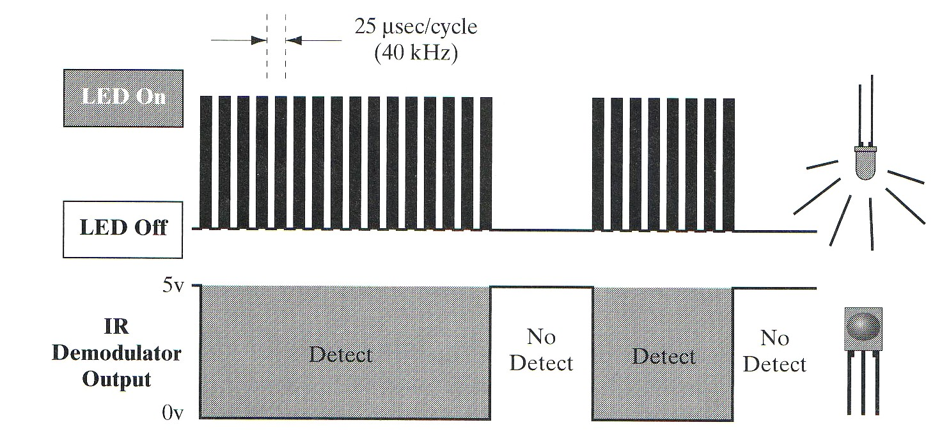
Modulated Infrared
Modulation and Demodulation
  Flashing a light source at a particular frequency
  Demodulator is tuned to the specific frequency of light flashes. (32kHz~45kHz)
  Flashes of light can be detected even if they are very week
  Less susceptible to ambient lighting and reflectivity of objects
  Used in most IR remote control units, proximity sensors
Negative true logic:
Detect = 0v
No detect = 5v

Slide 50

IR Proximity Sensors
amplifier
bandpass filter
integrator
limiter
demodulator
comparator
Proximity Sensors:
  Requires a modulated IR LED, a detector module with built-in modulation decoder
  Current through the IR LED should be limited: adding a series resistor in LED driver circuit
  Detection range: varies with different objects (shiny white card vs. dull black object)
  Insensitive to ambient light
Applications:
  Rough distance measurement
  Obstacle avoidance
  Wall following, line following

Slide 51


IR Distance Sensors
Basic principle of operation:
  IR emitter + focusing lens + position-sensitive detector
Modulated IR light
Location of the spot on the detector corresponds to the distance to the target surface, Optics to covert horizontal distance to vertical distance

Slide 52
IR Distance Sensors
Sharp GP2D02 IR Ranger
  Distance range: 10cm (4") ~ 80cm (30").
  Moderately reliable for distance measurement
  Immune to ambient light
  Impervious to color and reflectivity of object
  Applications: distance measurement, wall following, …

Slide 53
Basic Navigation Techniques
• Relative Positioning (called Dead-reckoning)
– Information required: incremental (internal)
    Velocity
    heading
– With this technique the position can be updated with respect to a starting point
– Problems: unbounded accumulation error
• Absolute Positioning
– Information Required: absolute (external)
– Absolute references (wall, corner, landmark)
– Methods
    Magnetic Compasses (absolute heading, earth’s magnetic field)
    Active Beacons
    Global Positioning Systems (GPS)
    Landmark Navigation (absolute references: wall, corner, artificial landmark)
    Map-based positioning

Slide 54

Dead Reckoning
Cause of unbounded accumulation error:
Systematic Errors:
Unequal wheel diameters
Average of both wheel diameters differs from nominal diameter
Misalignment of wheels
Limited encoder resolution, sampling rate, …
Nonsystematic Errors:
Travel over uneven floors
Travel over unexpected objects on the floor
Wheel-slippage due to : slippery floors; over-acceleration, fast turning (skidding), non-point wheel contact with the floor

Slide 55
Sensors used in navigation
Dead Reckoning
  Odometry (monitoring the wheel revolution to compute the offset from a known starting position)
    Encoders,
    Potentiometer,
    Tachometer, …
– Inertial Sensors (measure the second derivative of position)
    Gyroscopes,
    Accelerometer, …
External Sensors
  Compass
  Ultrasonic
  Laser range sensors
  Radar
  Vision
  Global Positioning System (GPS)

Slide 56
Motor Encoder

Slide 57


Incremental Optical Encoders
Relative position
- calibration ?
- direction ?
light sensor
- resolution ?
decode circuitry
light emitter
grating

Slide 58
Incremental Optical Encoders
Quiz 1:
If there are 100 lines in the grating, what is the smallest detectable change in motor-shaft angle?
Quiz 2:
How could you augment a grating-based (relative) encoder in order to detect the direction of rotation?
light emitter/detector

Slide 59
Incremental Optical Encoders
Relative position
- calibration ?
- direction ?
light sensor
- resolution ?
decode circuitry
light emitter
grating
A
A
A leads B
B
B

Slide 60
Incremental Optical Encoders
  Incremental Encoder:
light sensor
- direction
decode circuitry
- resolution
light emitter
grating
It generates pulses proportional to the rotation speed of the shaft.
• Direction can also be indicated with a two phase encoder:
A
B
A leads B

Slide 61

Incremental Optical Encoders
  Incremental Encoder:
A
B
A leads B
Encoder pulse and motor direction

Slide 62



Absolute Optical Encoders
Used when loss of reference is not possible.
Gray codes: only one bit changes at a time ( less uncertainty).
• The information is transferred in parallel form (many wires are necessary).
Binary
Gray Code
000
001
010
011
100
101
110
111
000
001
011
010
110
111
101
100

Slide 63


Other Odometry Sensors
Resolver
It has two stator windings positioned at 90 degrees. The output voltage is proportional to the sine or cosine function of the rotor's angle. The rotor is made up of a third winding, winding C
Potentiometer
= varying resistance

Slide 64
Range Finder
(Ultrasonic, Laser)

Slide 65

Range Finder
Time of Flight
The measured pulses typically come form ultrasonic, RF and optical energy sources.
  D = v * t
  D = round-trip distance
  v = speed of wave propagation
  t = elapsed time
Sound = 0.3 meters/msec
RF/light = 0.3 meters / ns (Very difficult to measure short distances 1-100 meters)

Slide 66

Ultrasonic Sensors
Basic principle of operation:
  Emit a quick burst of ultrasound (50kHz), (human hearing: 20Hz to 20kHz)
  Measure the elapsed time until the receiver indicates that an echo is detected.
  Determine how far away the nearest object is from the sensor
  D = v * t
  D = round-trip distance
  v = speed of propagation(340 m/s)
  t = elapsed time
Bat, dolphin, …

Slide 67

Ultrasonic Sensors
Ranging is accurate but bearing has a 30 degree uncertainty. The object can be located anywhere in the arc.
Typical ranges are of the order of several centimeters to 30 meters.
Another problem is the propagation time. The ultrasonic signal will take 200 msec to travel 60 meters. ( 30 meters roundtrip @ 340 m/s )

Slide 68


Polaroid Ultrasonic Sensors
  It was developed for an automatic camera focusing system
  Range: 6 inches to 35 feet
Transducer Ringing:
  transmitter + receiver @ 50 KHz
  Residual vibrations or ringing may be interpreted as the echo signal
  Blanking signal to block any return signals for the first 2.38ms after transmission
Electronic board
Ultrasonic transducer
http://www.acroname.com/robotics/info/articles/sonar/sonar.html

Slide 69

Operation with Polaroid Ultrasonic
The Electronic board supplied has the following I/0
  INIT : trigger the sensor, ( 16 pulses are transmitted )
  BLANKING : goes high to avoid detection of own signal
  ECHO : echo was detected.
  BINH : goes high to end the blanking (reduce blanking time < 2.38 ms)
  BLNK : to be generated if multiple echo is required
t

Slide 70

Ultrasonic Sensors
Applications:
  Distance Measurement
  Mapping: Rotating proximity scans (maps the proximity of objects surrounding the robot)
Scanning at an angle of 15º apart can achieve best results

Slide 71

Noise Issues

Slide 72

Laser Ranger Finder
Range 2-500 meters
Resolution : 10 mm
Field of view : 100 - 180 degrees
Angular resolution : 0.25 degrees
Scan time : 13 - 40 msec.
These lasers are more immune to Dust and Fog
http://www.sick.de/de/products/categories/safety/

Slide 73
Inertial Sensors
Gyroscopes
  Measure the rate of rotation independent of the coordinate frame
  Common applications:
    Heading sensors, Full Inertial Navigation systems (INS)
Accelerometers
  Measure accelerations with respect to an inertial frame
  Common applications:
    Tilt sensor in static applications, Vibration Analysis, Full INS Systems

Slide 74
Accelerometers
They measure the inertia force generated when a mass is affected by a change in velocity.
This force may change
  The tension of a string
  The deflection of a beam
  The vibrating frequency of a mass

Slide 75


Accelerometer
Main elements of an accelerometer:
Mass 2. Suspension mechanism 3. Sensing element
High quality accelerometers include a servo loop to improve the linearity of the sensor.

Slide 76

Gyroscopes
These devices return a signal proportional to the rotational velocity.
There is a large variety of gyroscopes that are based on different principles

Slide 77


Global Positioning System (GPS)
24 satellites (+several spares)
broadcast time, identity, orbital parameters (latitude, longitude, altitude)
http://www.cnde.iastate.edu/staff/swormley/gps/gps.html

Slide 78
Noise Issues
Real sensors are noisy
Origins: natural phenomena + less-than-ideal engineering
Consequences: limited accuracy and precision of measurements
Filtering:
  software: averaging, signal processing algorithm
  hardware tricky: capacitor

Slide 79

Thank you!
Homework 7 posted on the web
Due date: Nov. 18, 2008
Next class: Robot Motion Planning

